Slide 1
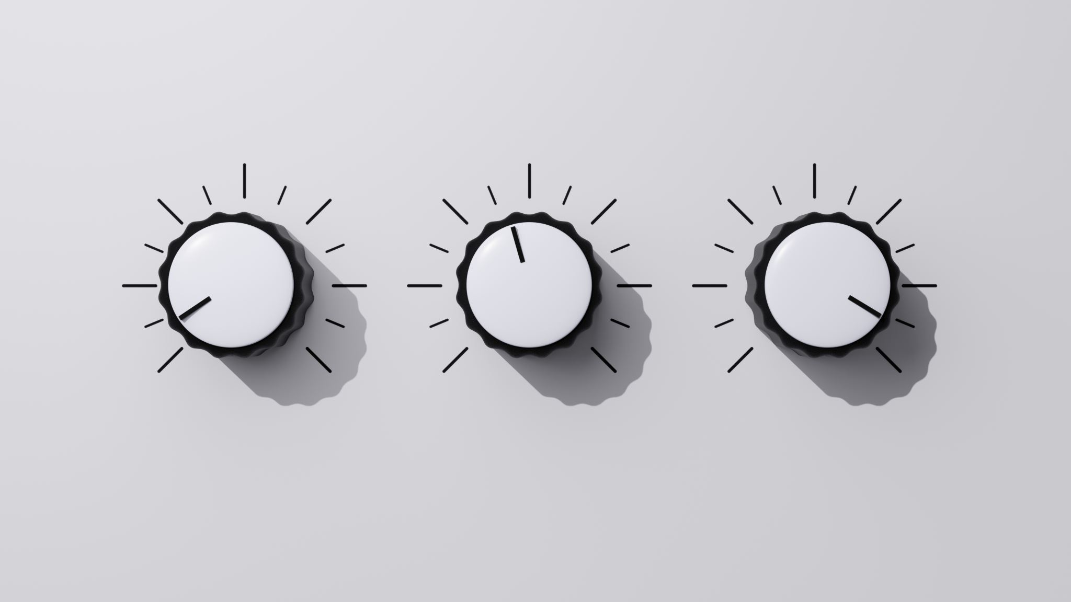
Electricity consumption analyzer

Slide 2
Worked and presented to you by:
Zeyad Saad Abdel-Fattah
Joesph George Wahba
Muhammed Ashraf El-Kateb
Zyad Gamal Saeed
Menna-Allah Ahmed
Abdelhalim Ramadan

Slide 3
Index
Introduction
Purpose of the Electricity Consumption Analyzer
Team members
2.Why Build the System?
Rising electricity costs
Lack of awareness
Environmental impact
Convenience and AI-powered insights
Project Structure
Requirements gathering
System design
Data collection and integration
Development phases
Final implementation and launch
Diagrams
Data flow and system flowcharts
5. Companies, Meters, and Costs
Analyzing cost structures
6. Requirements Determination
Functional and non-functional requirements
Goal and scope of the system
7 .Requirements Analysis Strategies
Problem and root cause analysis
Duration and activity-based costing
Benchmarking and technology analysis
8. Requirements Gathering Techniques
Interviews
Questionnaires
Joint Application Development (JAD)
Document analysis
Observation

Slide 4
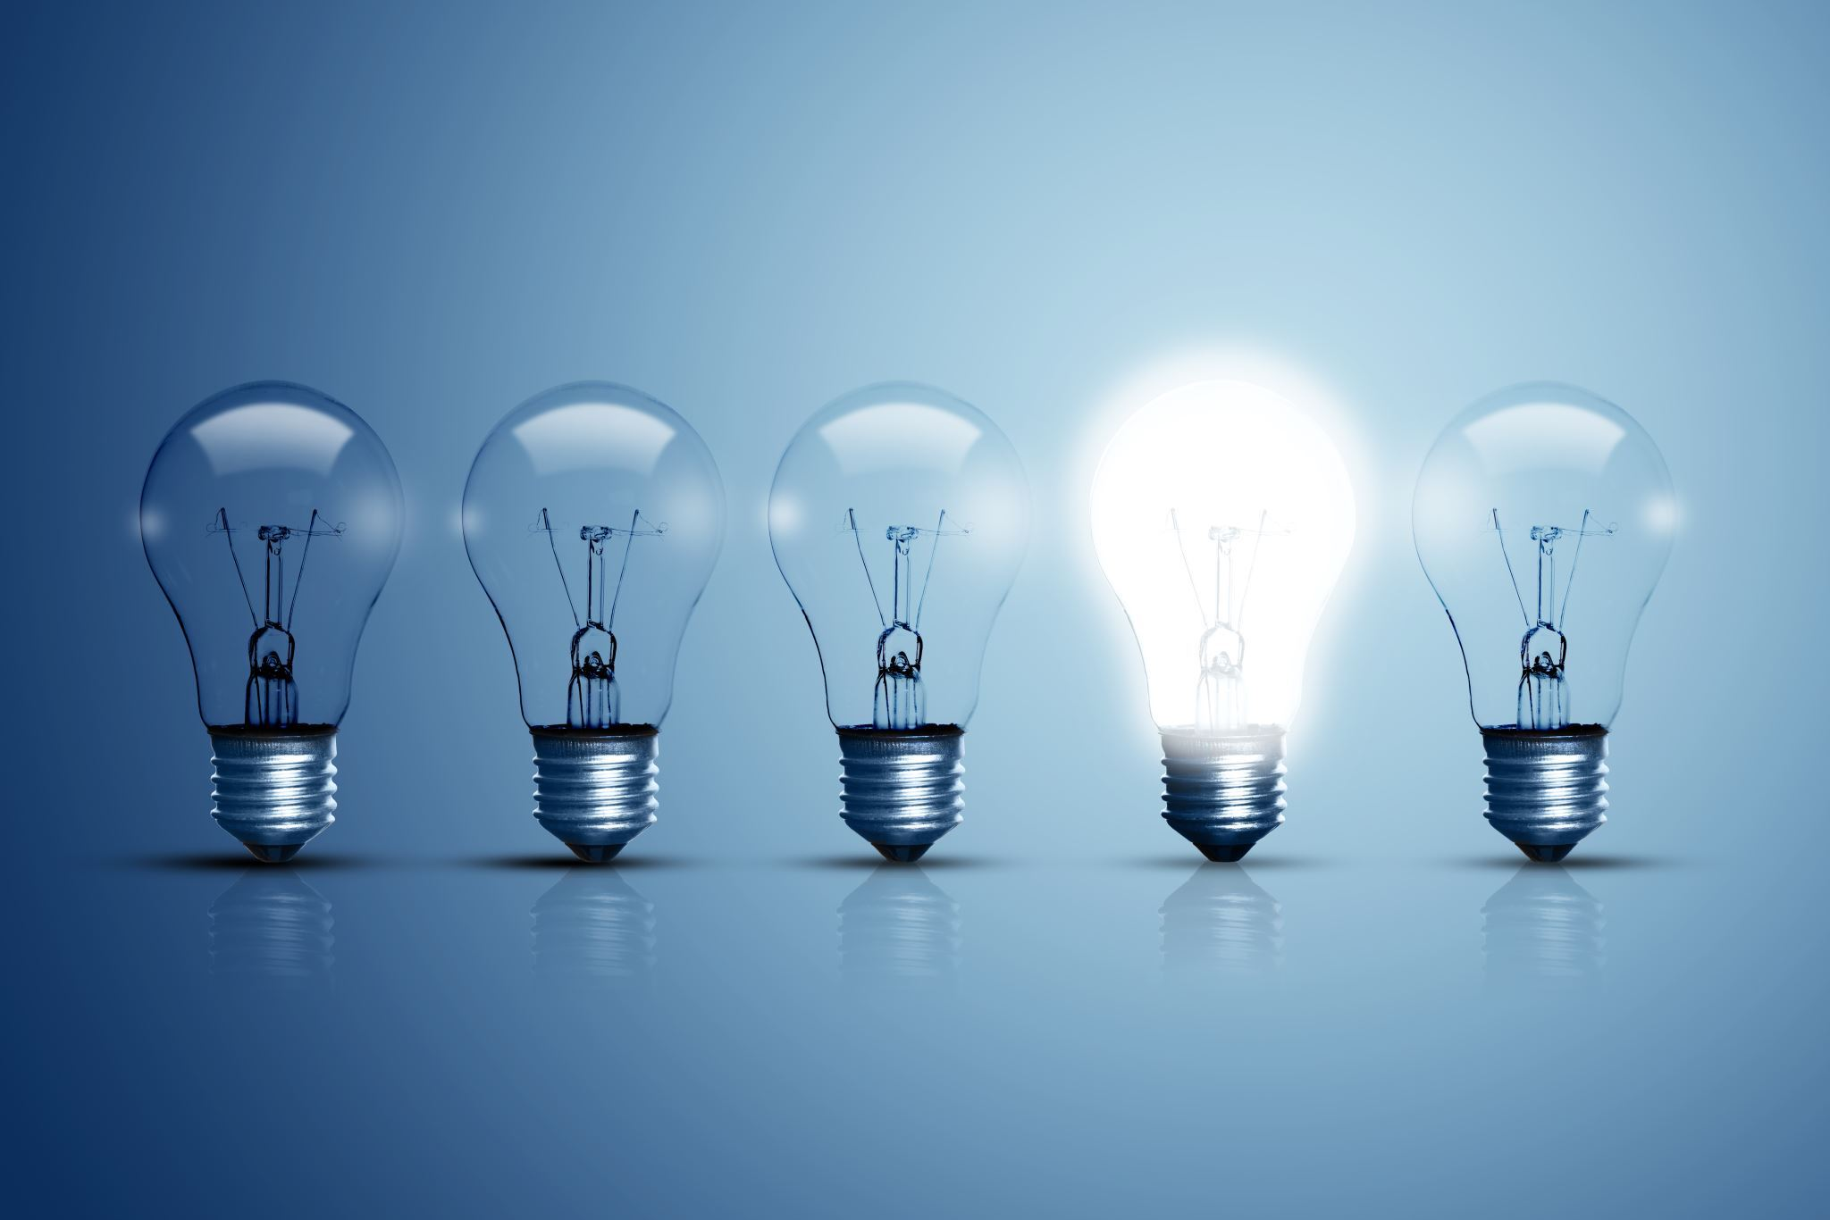
Why to build the system?
How to structure the project?
1. Rising Electricity Costs
Many households struggle with managing their electricity bills due to increasing rates and unpredictable consumption patterns.
2. Lack of Awareness
Users often don’t have a clear understanding of how much electricity they are using until they receive their bill.
3. Environmental Impact
Efficient energy usage can reduce overall consumption, which benefits the environment by lowering carbon footprints.
4. Convenience and Control
The system provides real-time updates on electricity consumption, helping users to stay within their budget and avoid unexpected expenses.
5. AI-Powered Insights
By integrating AI, the system offers personalized tips to optimize energy usage, leading to long-term savings and more energy-conscious behavior.

Slide 5
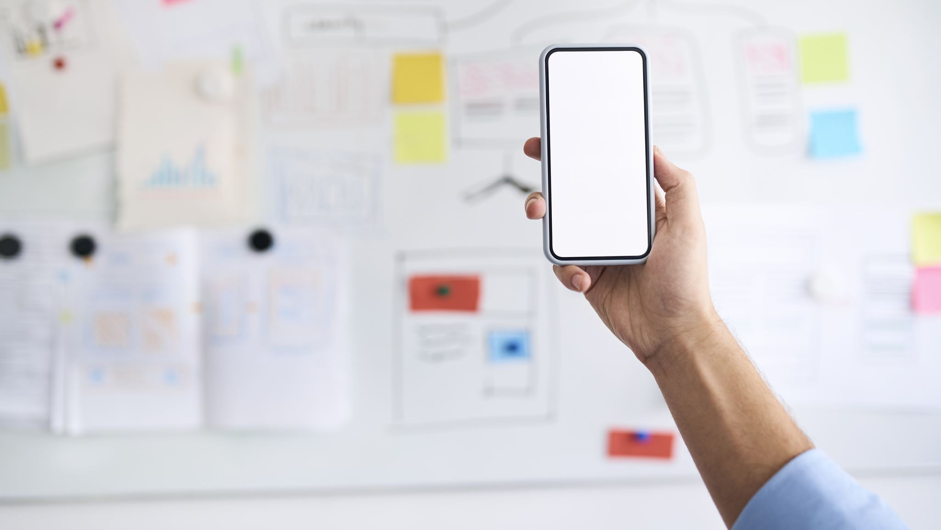
How to structure the project?
1. Requirements Gathering
Identify User Needs: Understand the target audience's pain points regarding electricity consumption and cost management
Define System Requirements: Specify core features such as consumption tracking, notifications, and AI recommendations
2. System Design
App Interface Design: Create an intuitive user interface for tracking consumption and receiving alerts
Backend Development: Design the system’s architecture, focusing on data collection, real-time analysis, and integration with AI algorithms
AI Algorithm Development: Build and train the machine learning model that provides energy-saving tips based on user data
3. Data Collection & Integration
Consumption Data: Collect real-time electricity usage data from smart meters or manual input by users
User Profile Data: Gather data on user habits (e.g., time of peak usage, appliance usage) for AI training

Slide 6
How to structure the project?
4. Development Phases
Phase 1: Prototype Development: Build a functional prototype of the app with core features (usage tracking, alerts).
Phase 2: AI Integration: Implement and train the AI algorithm for personalized energy-saving suggestions.
Phase 3: Testing & Iteration: Conduct user testing to refine features, UI, and the accuracy of AI predictions.
5. Final Implementation and Launch
Testing & Debugging: Ensure system reliability, accuracy, and usability.
Deployment: Launch the application with cloud integration for scalability.
Post-launch Support: Gather feedback and improve the app with new features and updates

Slide 7
Diagrams

Slide 8
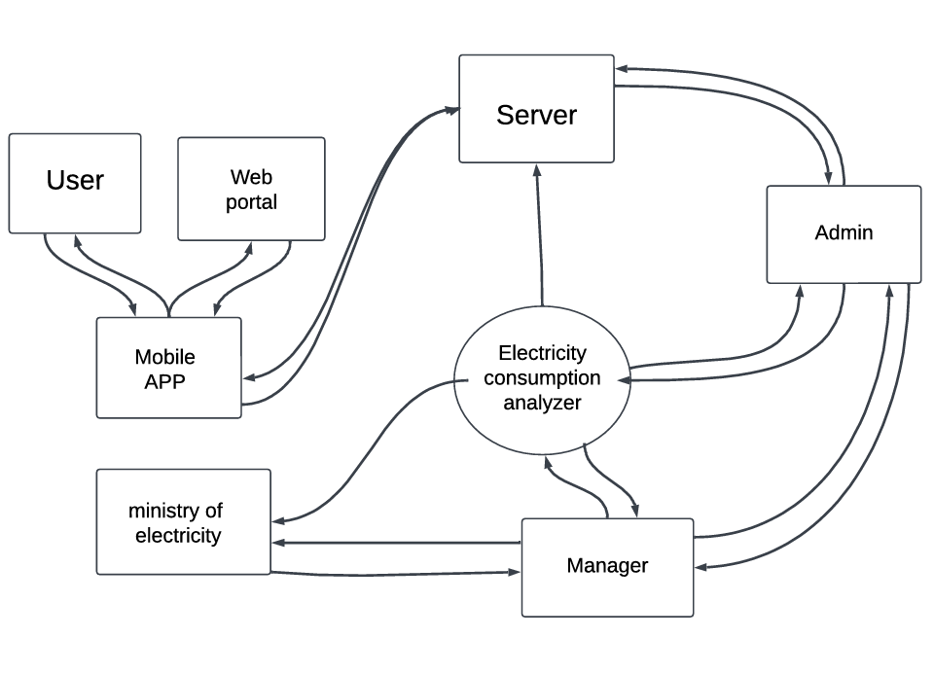
Context diagram

Slide 9
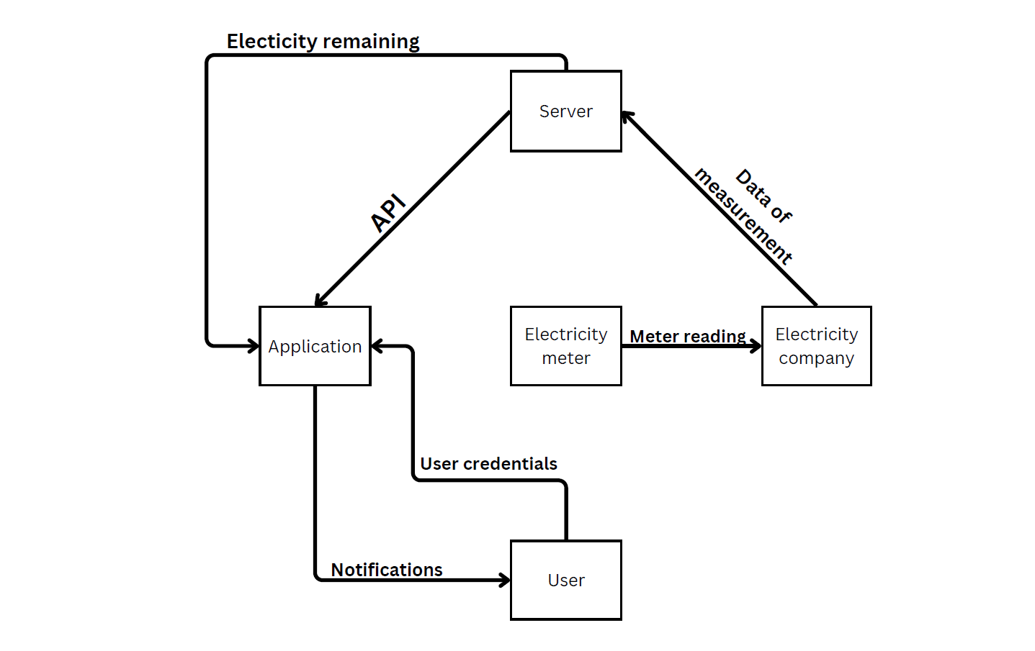
Data Flow
Diagrams

Slide 10
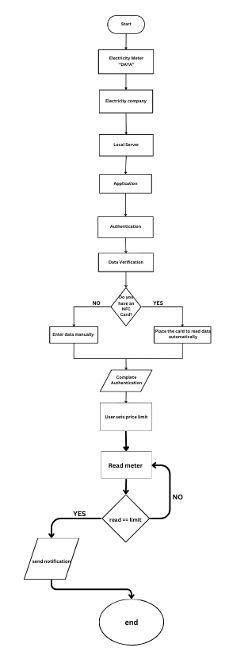
Flow chart
Diagrams

Slide 11
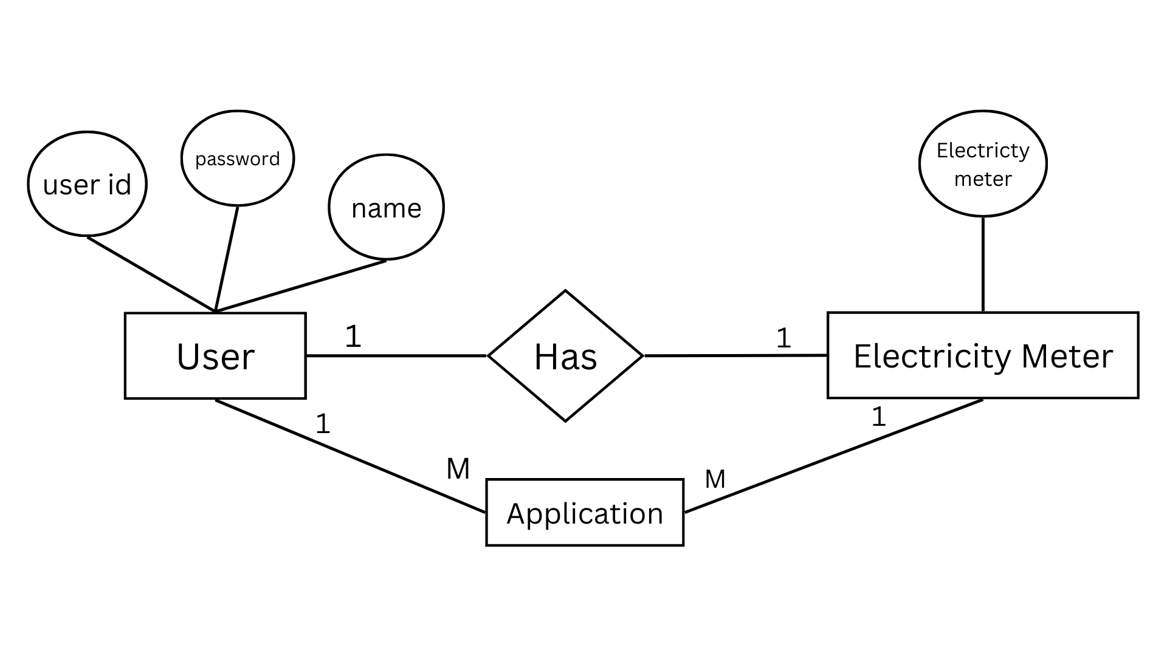
ERD

Slide 12
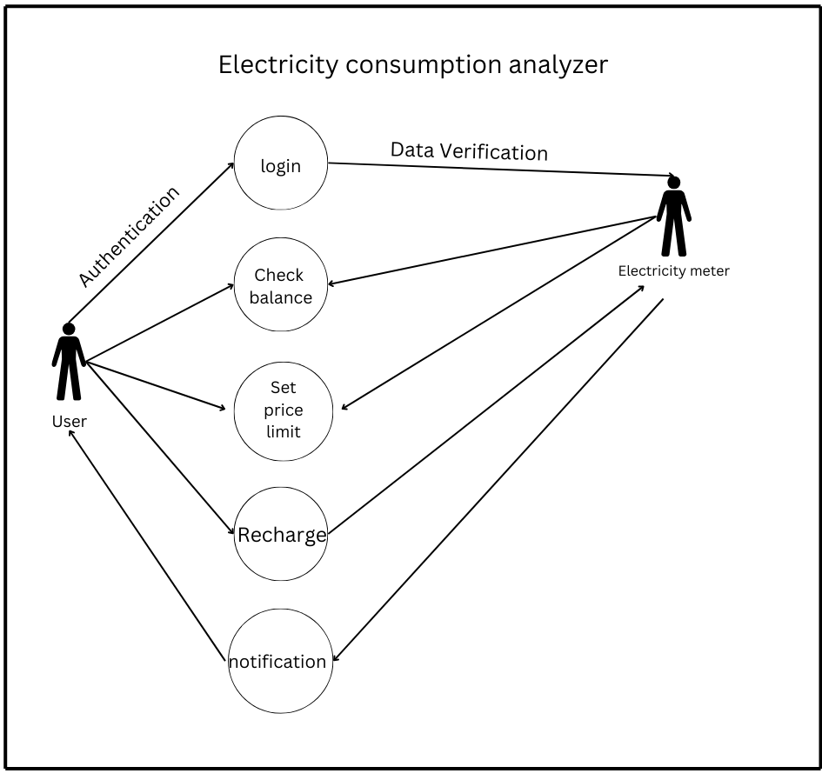
USE CASE DIAGRAM

Slide 13
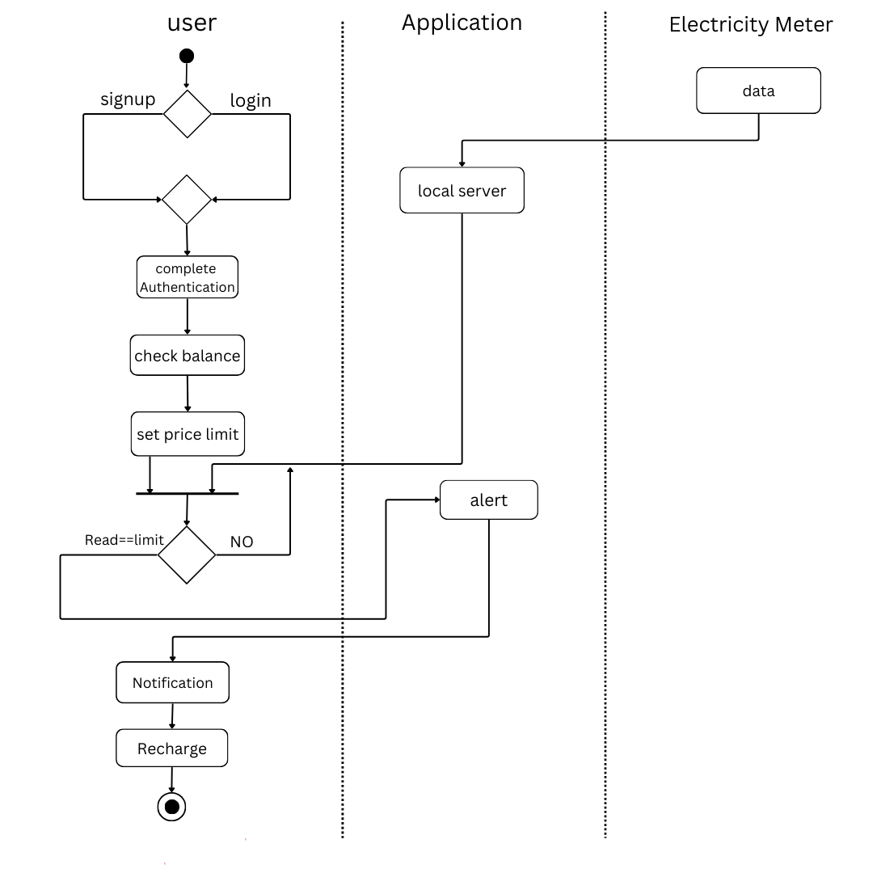
Activity Diagram

Slide 14
Use-Case Description

Slide 15
Use-Case Description
Use Case Name: Electricity Consumption Analyzer ID: 1
Importance Level: High Primary Actor: User
Stakeholders and Interests: Type: Extrnal
- User: Ensures sufficient balance for electricity usage.
- Electricity Meter: Tracks and verifies electricity consumption data.
Brief Description:
This use case describes how users log in, check their balance, set price limits, recharge accounts, and receive notifications related to electricity usage.
Trigger : The user interacts with the system to manage electricity consumption or balance
Relationships:
- Association: User, Electricity Meter
- Include: Check Balance, Recharge, Notification
- Extend: Set Price Limit

Slide 16
Normal Flow of Events:
1. Login:
- The user logs into the system for authentication.
- The system verifies the user’s credentials.
2. Check Balance:
- The user requests to view the remaining electricity balance.
- The system retrieves and displays the balance from the electricity meter.
3. Set Price Limit:
- The user sets a limit on electricity consumption.
- The system validates the limit and updates the user’s profile.

Slide 17
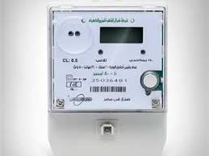
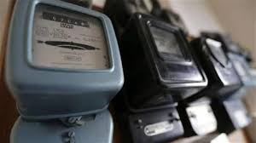
Companies , Meters and cost

Slide 18
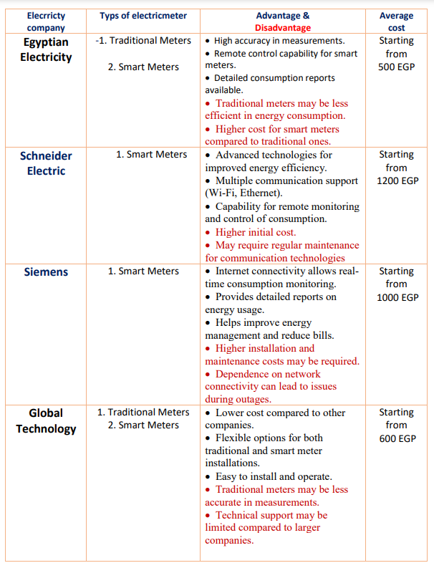
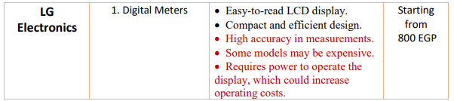
Companies , Meters and cost

Slide 19
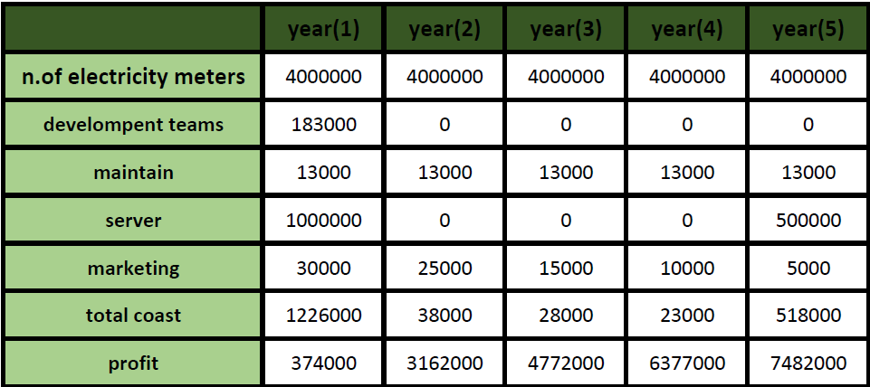
Cost

Slide 20
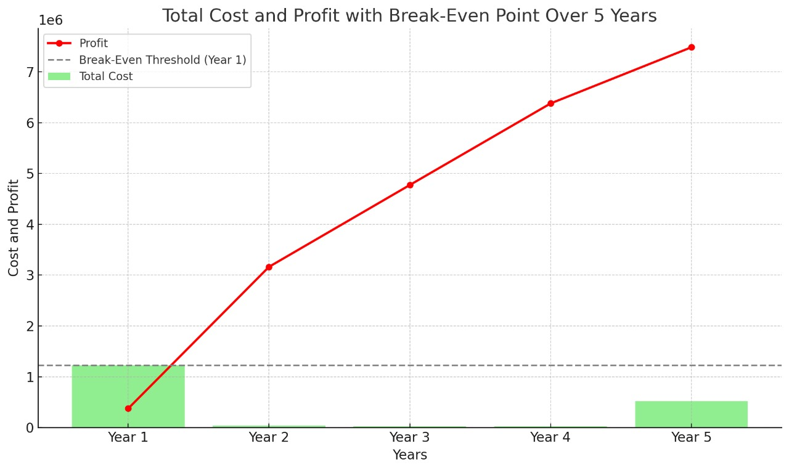
Cost

Slide 21
Cost

Slide 22
1Functional Requirements
Actions the system must perform, such as tracking and analyzing electricity consumption.
2Non-functional Requirements
Characteristics like system performance, usability, and data security.
3Goal
To establish clear, accurate requirements that fully address user needs while aligning with business objectives.
Requirements Determination

Slide 23
1Components:
Functional Requirements: Define specific actions, such as:
1Tracking real-time electricity consumption.
2Storing usage history per device.
3Generating and displaying AI-based recommendations to reduce usage.
Non-functional Requirements: Outline performance and quality expectations, including: 1Performance: System should handle multiple users with minimal delay in updating usage data.
2Usability: Easy-to-navigate interface, especially for non-technical users.
3Reliability: Accurate and timely consumption analysis.
4Security: Data encryption to protect user privacy.
Scope: Determines what the system will and won’t do, avoiding scope creep and unnecessary features that could increase costs or complexity.
Creating a Requirements Definition

Slide 24
Problem Analysis: - Objective: Identify issues with current energy management and determine how the system can provide solutions.
Root Cause Analysis: - Focus: Investigate underlying reasons for high electricity consumption. - Method: Work with users to list issues (e.g., overuse of certain appliances) and analyze their causes to inform system solutions.
Duration Analysis: - Purpose: Break down the time taken for each step in managing energy usage. - Insight: Identify areas where reducing or combining steps could enhance efficiency, such as scheduling device usage times.
Activity-Based Costing: - Purpose: Assess the costs tied to each electricity-using activity. - Application: Helps identify cost-saving opportunities through automated alerts or AI recommendations.
Informal Benchmarking: - Objective: Study similar energy-saving apps or platforms to identify best practices.
Technology Analysis: - Focus: Explore AI and data analysis technologies that could optimize the system’s advice on reducing usage.
Outcome Analysis: - Objective: Define the desired outcome, which is lower electricity bills and improved energy efficiency, and align system capabilities to achieve these results.
Requirements Analysis Strategies

Slide 25
Goal: Collect comprehensive user requirements, ensuring alignment between system functionality and user expectations.-
Techniques: Interviews: In-depth conversations to uncover specific needs and pain points.
Joint Application Development (JAD): Collaborative sessions involving users and analysts to define key requirements. -
Questionnaires: Distribute surveys to collect broader user feedback.
Document Analysis: Review existing energy management methods and relevant policies. -
Observation: Watch how users interact with current energy tracking systems to identify areas for improvement.
Requirements Gathering Techniques

Slide 26
Objective: Collect detailed, qualitative data directly from users and stakeholders.
Process: Selecting
Interviewees: Identify users with experience in managing energy consumption, such as frequent app users.
Designing Questions:
Open-ended: "What challenges do you face in managing your electricity usage?“
Closed-ended: "Do you monitor your daily electricity usage? (YesNo)“
Probing: "Can you elaborate on what causes unexpected spikes in usage?“
Interview Structure:Top-down: Start with broad questions about overall usage habits.
Bottom-up: Dive into specifics, such as individual device usage.Follow-up: Summarize findings, verify with interviewees, and adjust requirements based on feedback.
Interviews

Slide 27
Purpose: Gather information from a larger user base efficiently.
1- Steps:
Selecting Participants: Choose a representative sample of users.
Designing Questions: Clear, straightforward questions are essential to avoid ambiguity.
Administering the Questionnaire: Use incentives, like small rewards, to boost response rates
Follow up: Share results with respondents to reinforce trust and thank them for their input.
2- Design Tips:
Begin with non-threatening questions.
Group similar questions together for logical flow.
Pre-test the questionnaire to identify any confusing items.
Questionnaires

Slide 28
Questionnaires
High-Level (Very General)
How can users better understand and control their electricity consumption?
What strategies can make energy-saving systems more accessible to a wider audience?
How can technology contribute to reducing overall energy waste globally?
Medium-Level (Moderately Specific)
How can the app notify users in real time about high energy consumption without overwhelming them?
How can we optimize AI-generated recommendations to suit different household sizes and energy needs?
What methods can be implemented to predict electricity cost fluctuations for users in advance?
How can we integrate renewable energy data into the consumption analyzer for more eco-friendly suggestions?
How can we balance system complexity with user-friendliness in the app interface design?
Low-Level (Very Specific)
How can we ensure compatibility between smart meters from different providers and the system?
What specific data encryption techniques should be used to ensure user privacy during data transfer?
How can we provide accurate feedback about which appliances cause peak consumption periods?
How can we include scheduling features to automate energy-saving measures for high-consumption devices?
How can the system predict potential device malfunctions based on energy consumption irregularities?
How can we design a tutorial or onboarding process to teach users how to interpret app insights effectively?

Slide 29
Questionnaires
High-Level Questions (30% = 120 responses):
50 people (41.7%) responded to "How can users better understand and control their electricity consumption?"
40 people (33.3%) responded to "What strategies can make energy-saving systems more accessible?"
30 people (25%) responded to "How can technology contribute to reducing overall energy waste globally?“

Slide 30
Questionnaires
Medium-Level Questions (40% = 160 responses):
30 people (18.8%) responded to "How can the app notify users in real-time about high energy consumption?"
30 people (18.8%) responded to "How can we optimize AI-generated recommendations for different households?"
30 people (18.8%) responded to "What methods can predict electricity cost fluctuations?"
35 people (21.9%) responded to "How to integrate renewable energy data into the analyzer?"
35 people (21.9%) responded to "How can we balance system complexity with user-friendliness?"

Slide 31
Questionnaires
Low-Level Questions (30% = 120 responses):
15 people (12.5%) responded to "How can we ensure compatibility between smart meters and the system?"
15 people (12.5%) responded to "What specific encryption techniques should be used?"
20 people (16.7%) responded to "How can we provide accurate feedback about appliances causing peak consumption?"
20 people (16.7%) responded to "How can we include scheduling features to automate energy-saving measures?"
25 people (20.8%) responded to "How can the system predict device malfunctions?"
25 people (20.8%) responded to "How can we design a tutorial or onboarding process for app insights?"

Slide 32
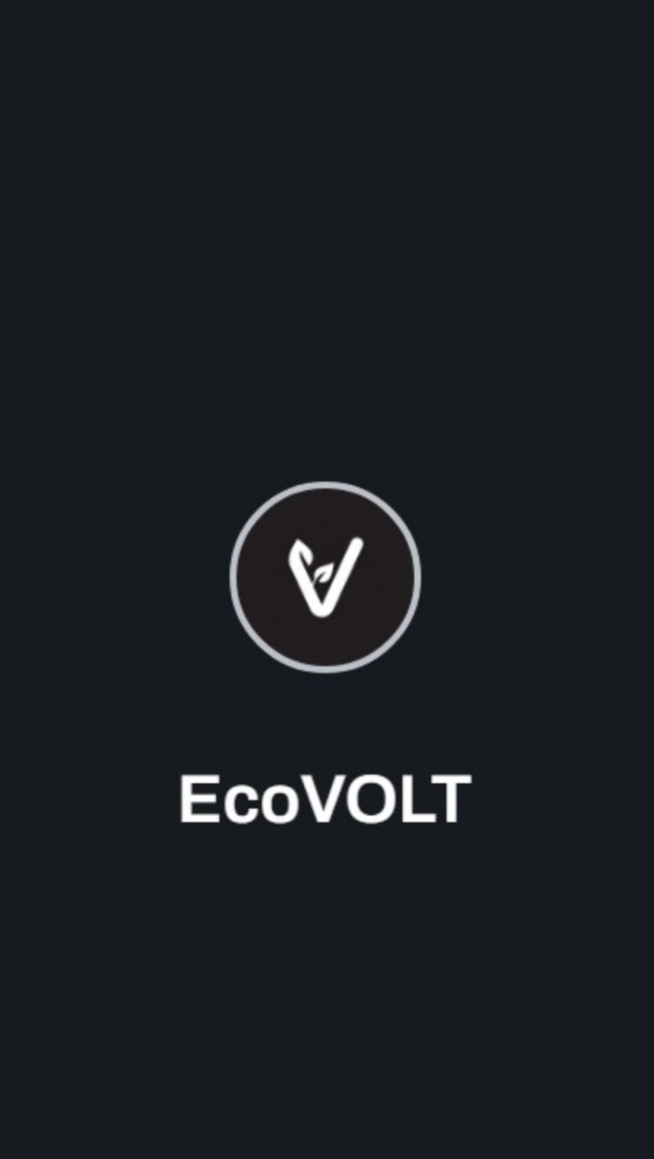
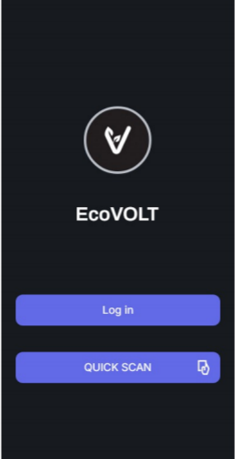
Application user interface (UI)

Slide 33
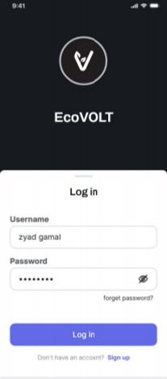
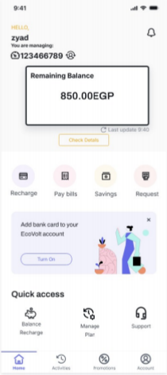
NEXT

Slide 34
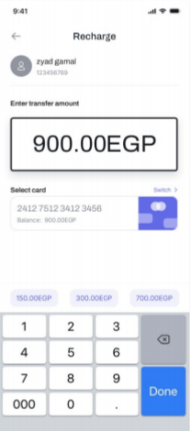
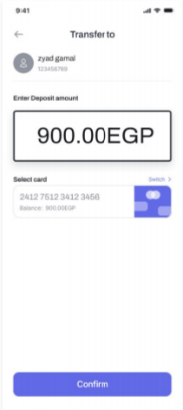
NEXT

Slide 35
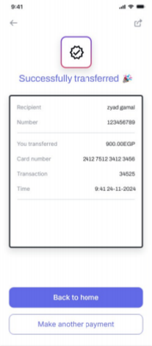
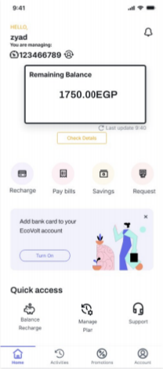
NEXT

Slide 36
NEXT

Slide 37
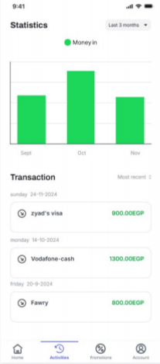
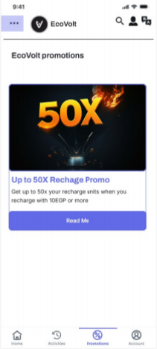
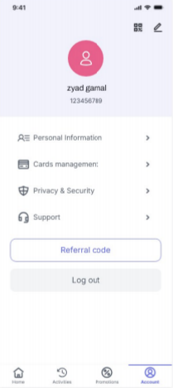
NEXT

